Slide 1
Touch For Food February 12 Meeting
CloudNine

Slide 2
Agenda
Announcements
Retrospective Sprint 7
Scrum updates w/ presentations
Goals
Schedule
Use Cases and Test Cases
General Issues

Slide 3
Announcements
Presentations: Thursday, April 4
Don’t forget to make an individual appointment with Dr. Constantinides
Making our submission by Wednesday night
System Sequence Diagrams vs. Sequence Diagrams
Create Menu Activity Diagram?

Slide 4
Retrospective – Sprint 7
No stories closed
Need to focus on finishing up the stories

Slide 5
Scrum update w/ presentation
6 minutes each

Slide 6
Goals
Todo:
Finish Search Unit Test
Finish Toppings and sides
Finish Customer Bill Management
Finish Reviews
Finish retroactive unit testing
Fix flow, ensure all closed stories work the way they should (data validation, etc.)
Android/iPhone mobile wrapper
See backlog for any new tasks/bugs added

Slide 7
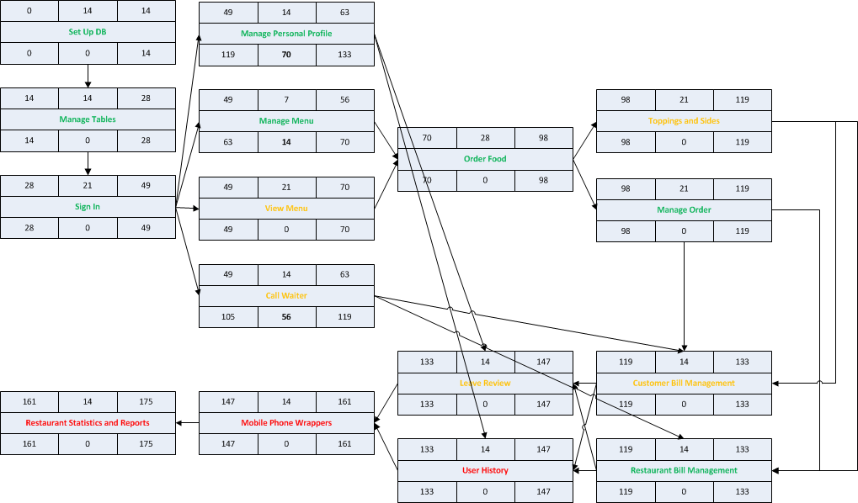
Schedule

Slide 8
Schedule
Sprint 8
Finish Search Unit test (Josh)
Android wrapper (Chris)
iPhone wrapper (Cristian)
QA (Josh)
Retroactive unit testing (Katrina)
Toppings and sides (Matt)
Bugs (Ryan and Chris)
Reviews (Mike)
User History (Patrick)
Restaurant Stats & Reports (Cynthia)
Flow fixer? (anyone pick tasks up if they have time)

Slide 9
Use Cases and Test Cases
Katrina

Slide 10
Questions?

